Slide 1
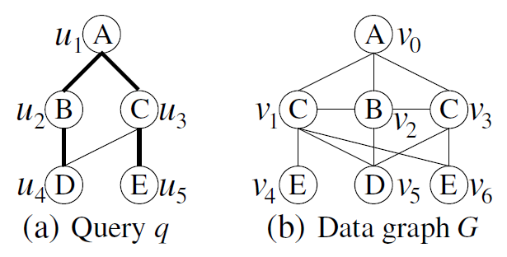
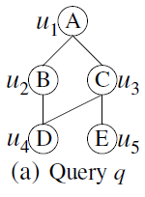
All-Matching
Subgraph Matching
Given a query q and a large data graph G, the problem is
to extract all subgraph isomorphic（同构） embeddings of q in G.
There are three subgraph isomorphic embeddings of q in G.

Slide 2
All-Matching
Subgraph Matching
Given a query q and a large data graph G, the problem is
to extract all subgraph isomorphic embeddings of q in G.
Embedding One
u₁ | u₂ | u₃ | u₄ | u₅
v₀ | v₂ | v₁ | v₅ | v₄

Slide 3
All-Matching
Subgraph Matching
Given a query q and a large data graph G, the problem is
to extract all subgraph isomorphic embeddings of q in G.
Embedding Two
u₁ | u₂ | u₃ | u₄ | u₅
v₀ | v₂ | v₁ | v₅ | v₆

Slide 4
All-Matching
Subgraph Matching
Given a query q and a large data graph G, the problem is
to extract all subgraph isomorphic embeddings of q in G.
Embedding Three
u₁ | u₂ | u₃ | u₄ | u₅
v₀ | v₂ | v₃ | v₅ | v₆

Slide 5
Existing Work
Ullmann’s algorithm [J.ACM’76]
First algorithm to enumerate all subgraph isomorphic embeddings
A backtracking algorithm that maps query vertices one by one, following a random order.
Example: A random order for query q could be (u₁, u₄, u₂, u₃, u₅)
Notes:
Subgraph matching is a problem that has been studied for decades.
The first algorithm is Ullman’s algorithm proposed in 1976, which iteratively finds matching for query vertices one by one following a random order.
Apparently such a input order is actually random, which would require performing cartesian products between candidates of query vertices.

Slide 6
Existing Work
Ullmann’s algorithm [J.ACM’76]
First algorithm to enumerate all subgraph isomorphic embeddings
A backtracking algorithm that maps query vertices one by one, following a random order.
Example: A random order for query q could be (u₁, u₄, u₂, u₃, u₅)
Notes:
Subgraph matching is a problem that has been studied for decades.
The first algorithm is Ullman’s algorithm proposed in 1976, which iteratively finds matching for query vertices one by one following a random order.
Apparently such a input order is actually random, which would require performing cartesian products between candidates of query vertices.

Slide 7
Existing Work
VF2 [IEEE Trans’04] and QuickSI [VLDB’08]
Independently propose to enforce connectivity of the matching order
Example : A connected order for query q could be (u₁, u₂, u₄, u₃, u₅)
QuickSI further removes false-positive intermediate results by first
processing infrequent query vertices and edges.
Notes:
In order to solve the problem of random matching order, VF2 and QuickSI proposed connected matching order.
// which requires that each vertex in the matching order would have at least one edge connected to the vertices before it.
QuickSI further removes false-positive candidates by giving priority to infrequent vertices and edges when processing them.
A connected order of this query graph could be ().
By using this connected matched order, the cartesian products can be reduced when checking the connectivity between vertices.

Slide 8
Subgraph Matching
Nevertheless, it is still very difficult to enumerate subgraph matchings.
Due to 1) Data graph could be very large and dense.
2) There could be exponential number of embeddings of q in G.
Two Advanced Approaches.
TurboISO
CFL-Match

Slide 9
TurboISO Overview
Data Graph G
Construct based on query tree
Auxiliary Data Structure
Enumerate embeddings with a matching order
Query q
Query Rewrite
Query Tree
Result

Slide 10
TurboISO Overview
Data Graph G
Construct based on query tree
Auxiliary Data Structure
Enumerate embeddings with a matching order
Query q
Query Rewrite
Query Tree
Result
Key Techniques
Neighborhood Equivalence Class (NEC)
Merging vertices with same neighbors to reduce query size
Combine / Permute strategy to enumerate results
Candidate Region Exploration
Constructed on-the-fly based on q
A path-based data structure containing all embeddings of q in G
Will be explained with example in detail.

Slide 11




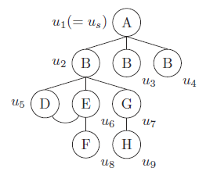
Neighborhood Equivalence Class(NEC)
Definition
Let be an equivalence relation over all query vertices in q such that, if for every embedding m that contains and , there exists an embedding m’ such that
Example
u₃ and u₄ are equivalent.
The Neighborhood Equivalence Class(NEC) of a query vertex u is
a set of query vertices, which are equivalent to u.
Notes:
Definition about NEC
An example of NEC nodes in a graph

Slide 12



Query Rewrite
Given a query q, we rewrite it into a NEC Tree in following steps:
Root Node Selection
Ranking function
: number of data vertices in g that have label l
: the degree of u
The vertex with smallest ranking value will be selected as the root node.

Slide 13
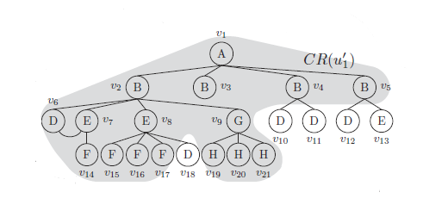

Query Rewrite
Given a query q, we rewrite it into a NEC Tree in following steps:
Root Node Selection
Ranking function
Rank(u₁) = 1 / 3
Rank(u₂) = 4 / 4
Rank(u₃) = 4 / 1
Rank(u₄) = 4 / 1
Rank(u₅) = 5 / 2
Rank(u₆) = 3 / 3
Rank(u₇) = 1 / 2
Rank(u₈) = 4 / 1
Rank(u₉) = 3 / 1
Hence, u₁ is selected as the root node.

Slide 14
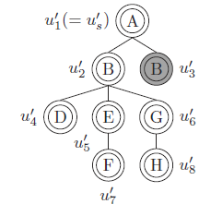

Query Rewrite
Given a query q, we rewrite it into a NEC Tree in following steps:
Rewrite to NEC Tree by
Performing BFS from the root node
Merging vertices from same NEC into a single vertex
Example
u₁ has been selected as the root node in the previous step.

Slide 15
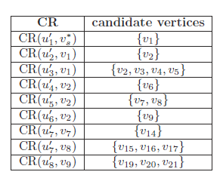
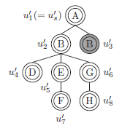
Candidate Region Exploration
Candidate Subregion
Candidate subregion denoted as CR(u, v), contains data vertices such that they match u and are child vertices of v in the DFS tree, where u is an NEC vertex, and v is a data vertex.
CR(u₂’, v₁) represents the candidates for u₂’ of NEC tree q’ in g,
with u₁’ (the parent of u₂’ in q’) mapped to v₁.

Slide 16
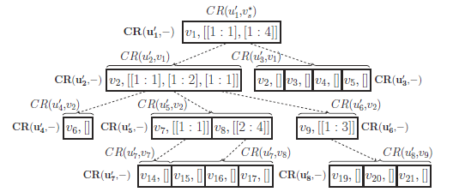
Candidate Region Exploration
Candidate Region
Organize all candidate subregions together
It has the same structure as the NEC tree
To facilitate the embedding enumeration.
The candidate region of the previous example

Slide 17
Candidate Region Exploration
To enumerate embeddings of query q in data graph G,
Only traverse the candidate region
Probe G only for non-tree edges validation
Non-tree edges are the edges in query graph q but not in NEC Tree q’.
(u₅, u₆) is a non-tree edge.

Slide 18
Candidate Region Exploration
To enumerate embeddings of q in G,
Only traverse the candidate region
Probe G only for non-tree edges validation
Example
Validate non-tree edge (u₅, u₆) here using G.
Matching two vertices because u₃’ contains two query nodes.
With matching order
(u₁’, u₂’, u₄’, u₅’, u₇’, u₃’, u₆’, u₈’,)
Combine / Permute to get all embeddings based on each NEC node.
In this example, as NEC node u₃’ contains two query nodes, this embedding corresponds to 2 embeddings by permuting v₂ and v₃.

Slide 19
CFL-Match
Overview of CFL-Match
A New Search Framework
Core-Forest-Leaf based query decomposition
Postpone Cartesian product with search order of core, forest and leaf
Comact Auxiliary Data Structure
Linear to the size of the data graph G
In contrast to the exponential sized data structure in TurboISO

Slide 20
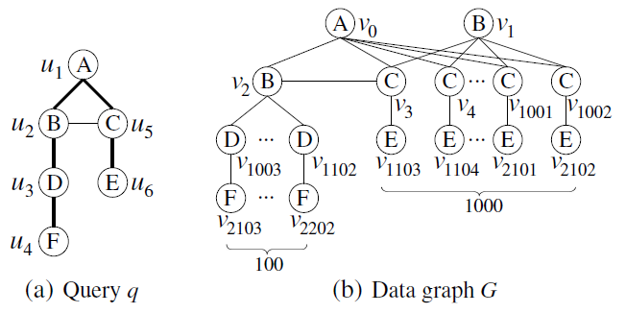
Challenges of Subgraph Matching
Challenge I: Redundant Cartesian Products by Dissimilar Vertices.
10⁵ - 100 partial mappings are redundant.
Matching order of QuickSI and Turbo_{ISO} : (u₁，u₂，u₃，u₄，u₅，u₆).
(u₁，u₂，u₅，u₃，u₄，u₆)
Cartesian products:
100 mappings (v₀，v₂， v_{1000+i}， v_{2100 +i}) (3 ≤ i ≤ 102) of (u₁，u₂，u₃，u₄)
1000 mappings (v₀, v_{j}) (3 ≤ j ≤ 1002) of (u₁，u₅)
Notes:
Nevertheless, subgraph matching is a still very challenging problem. Here, we will demonstrate the two main challenges that we deal with in this work.
The first challenge is that, the matching order of the existing work , results in too many Redundant Cartesian Products by Dissimilar Vertices.
Let’s use a simple example to explain this.
Consider this query q and data graph G. The matching order generated by QuickSI and TurboISO would be …..
With this matching order, when matching the vertex “u5”, we have to perform cartesian product between the 100 partial mappings of u1 u2 u3 u4 and 1000 partial mappings of u1 and u5.
However, as there is one edge in G can be mapped to the edge u2 u5, so the majority of partial mappings are actually redundant.
Our observation here is that by selecting a matching order that verifies the edge u2 u5 in an early stage, we can avoid generating such a large number of invliad partial mappings.

Slide 21
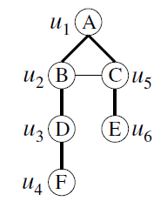
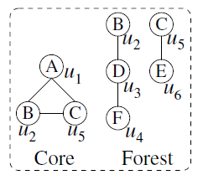
Challenges of Subgraph Matching
Challenge I: Redundant Cartesian Products by Dissimilar Vertices.
Our Solution : Postpone Cartesian products.
Decompose q into a dense subgraph and a forest, and process the dense subgraph first.
Notes:
So, our solution to this challenge is to postpone cartesian products,
by decomposing the query graph into a dense subgraph and a forest, then processing the dense subgraph first.
Because the dense subgraph has more edges connectivity info,
Processing it first gives us a better chance to prune out the unpromising partial results in an early stage.

Slide 22
Challenges of Subgraph Matching
Challenge II: Exponential size of the path-based data structure in TurboISO.
TurboISO builds a data structure that materializes all embeddings of query paths in a data graph
Worst-case space complexity: O(|V(G)|^{|v(q)-1|}).
Notes:
The second challenge is that the path-based data structure built in the existing work has an exponential size, which makes it infeasible to process large data or query.
The state-of-the-art method TurboISO builds a data structure to materialize all embeddings, in order to generate matching order and enumerate results.
Although such a data structure can greatly facilitate the search process, it’s worst case space complexity is exponential. (it’s inevitably got an exponential space complexity in the worst case.)

Slide 23
Challenges of Subgraph Matching
Challenge II: Exponential size of the path-based data structure in TurboISO.
Our Solution:
Polynomial-size data structure, compact path-index (CPI) .
Notes:
Our solution to this challenge here is to develop data structure CPI of polynomial size, that only stores the candidate embeddings, instead of materailizing all of them.
//While minimize the size of CPI is NP-hard, we propose a heuristic method to generate the CPI in polynomial time.

Slide 24
Our Approach
CFL-Match
A Core-Forest-Leaf decomposition based Framework
Compact Path-Index (CPI) based Matching
Data Graph G
Construct a linear sized data structure
CPI
Enumerate embeddings
with CFL framework
Query Decomposition
Query Rewrite
Result
Query q
Query Tree
Notes:
Next, I’ll formally present our approach CFL-Match, which consists of the following two parts:
a new framework based on CFL decomposition and our new proposed data structure for matching order generation and mapping extraction.

Slide 25
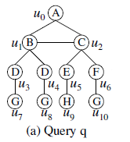
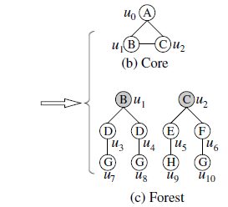
Core-Forest-Leaf Decomposition
Core-Forest Decomposition
Compute the minimal connected subgraph c containing all non-tree edges of q regarding any spanning tree.
The subgraph c is the core-structure of q , denoted as V_{C}.
The subgraph of q consisting of all other edges not in the c, is called the forest-structure of q, denoted as V_{T}.

Slide 26
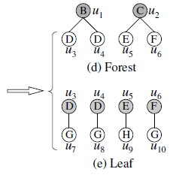
Core-Forest-Leaf Decomposition
Forest-Leaf Decomposition
Compute the set V_{I} of leaf vertices (degree-one vertices) by rooting each tree at its connection vertex.
The set V_{I} is called the leaf set.
The set of vertices not in V_{C} U V_{I} is called the forest set.

Slide 27
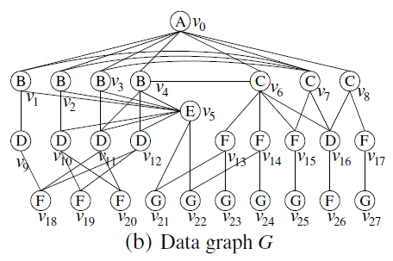
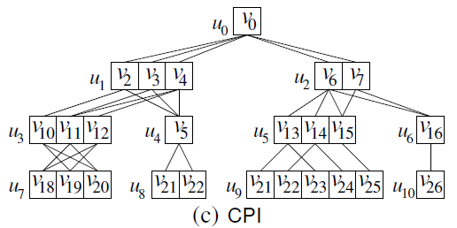
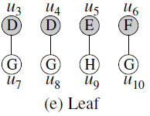
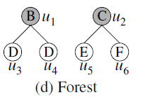



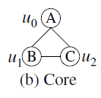
CFL-Match
A Core-Forest Leaf based Framework
Core-Forest-Leaf Decomposition
Construct CPI (will be explained later)
Mapping Extraction
Core-Match
Forest-Match
Leaf-Match
Categorize leaf nodes according to label
Perform combination instead of enumeration among different labels.
Notes:
Here, we present the CFL-Match: a A CFL-Decomposition based Framework.
The first step is to decompose the query graph q into the three substructures. Then we build the auxiliary data structure CPI to facilitate the matching in the next step and CPI construction method will be presented in the later slides.
Next, using the CPI, the subgraph matching is performed in a substructure-by-substructure manner, following a core-forest-leaf order. Specifically, for each embedding of core structure, we find an embedding for the forest substructure, then we extract all embeddings for leaf vertices based on core embedding and forest embedding.
During the leaf match, we categorize all leaf nodes into different label sets according to their node label, such that we can perform combination of mappings of each label, instead of enumerating them all. For the detail of the leaf match, please refer to our paper.

Slide 28
Auxiliary Data Structure
Compact Path-Index (CPI)
Compactly store all candidate embeddings of the query tree.
CPI Structure
Candidate sets
Each query node u has a candidate set u.C.
Edge sets
This is an edge between v ∈ u.C and v’ ∈ u’.C for adjacent query nodes u and u’ in CPI if and only if (v, v’) exists in G.
Notes:
For the auxiliary data structure, we propose compact path-index, in order to store candidate embeddings of all paths and serve for matching order computing.
CPI structure consists of two parts: a candidate set for each vertex u in the query graph, and an edge set. The edge set contains the edges among the candidates. An edge e in data graph is in the edge set of the CPI, if and only if both end of this edge is in the different candidate set of CPI.
//For example, the structure here is the CPI built for the query q based on the data graph G.

Slide 29
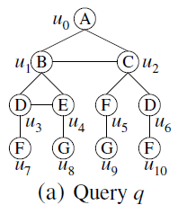
Auxiliary Data Structure
Compact Path-Index (CPI)
Compactly store all candidate embeddings of the query tree.
CPI Structure
Example
Notes:
Let’s use a simple example to demonstrate the CPI structure.
Given a query graph q and data graph G, the constructed CPI is like this.

Slide 30
Auxiliary Data Structure
Soundness of CPI
For every query node u in CPI, if there is an embedding of q in G that maps u to v, then v must be in u.C.
Given a sound CPI, all embeddings of q in G can be computed by traversing only the CPI while G is only probed for non-tree edge checkings.
The CPI in the previous example is a sound CPI.
Theorem
Notes:
One important feature of CPI is its soudness.

Slide 31
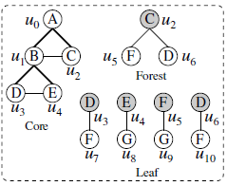
CPI-based Match
Traverse CPI to find mappings for query vertices
Only probe G for non-tree edge validation
Validate non-tree edge (u₁, u₂)
Validate non-tree edge (u₃, u₄)
Found an embedding!
Matching order (u₀，u₁，u₄，u₃，u₂, u₅, u₆, u_{7,} u₈, u₉, u₁₀)
Tree
Forest
Leaf
Notes:
Next, we quickly explain how to use CPI for core match and forest match.

Slide 32
Summary
Graph Pattern Matching in Graph Database
Three index-based methods: G-Index, FG-Index, Swift-Index
Advanced subgraph isomorphism testing: QuickSI
Graph Pattern Matching in Single Large Data Graph
TurboISO
Reduce query size using NEC
Candidate Region Exploration
CFL-Match
CFL-Framework based on query decomposition
Compact data structure CPI

Slide 33

Thank you!
Questions?

